Slide 1
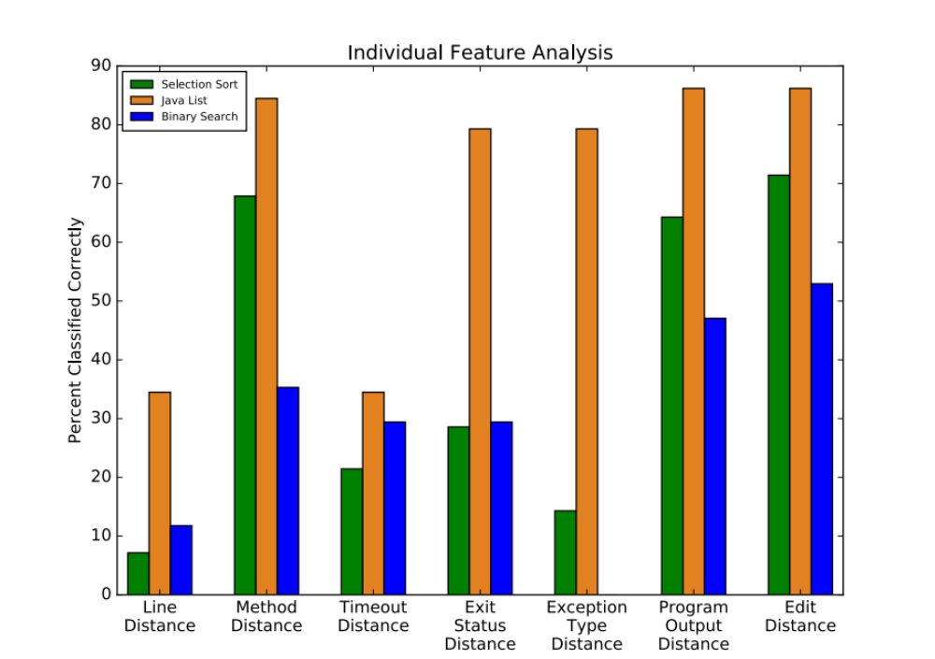
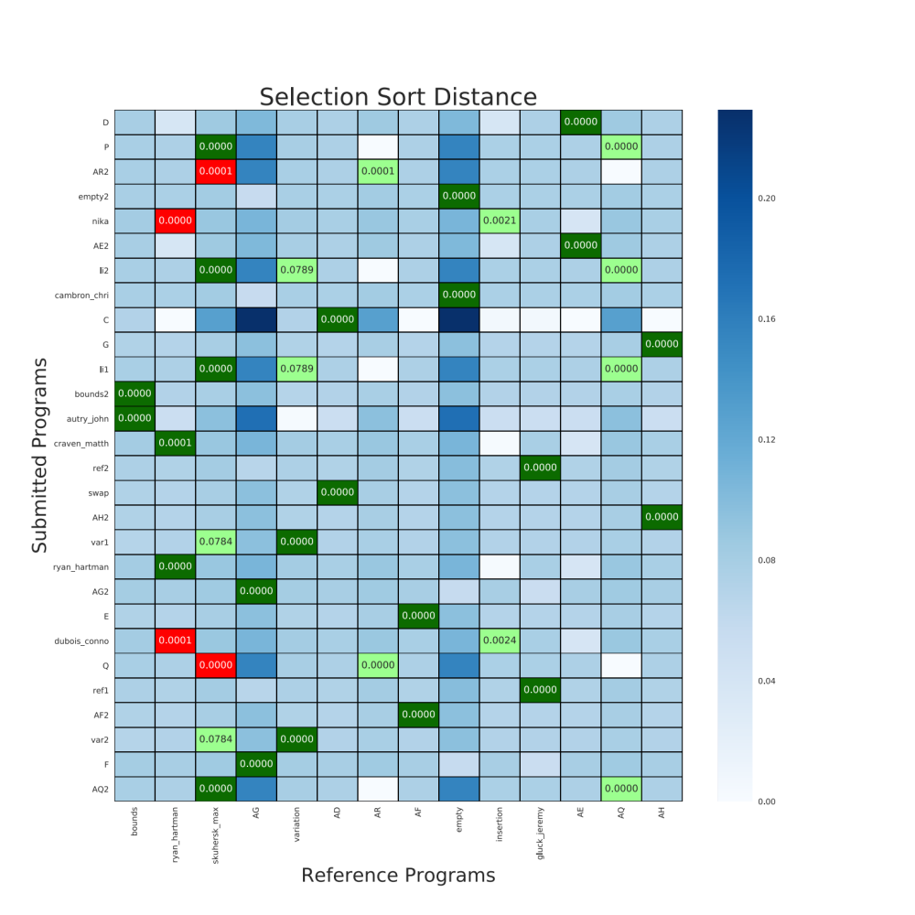
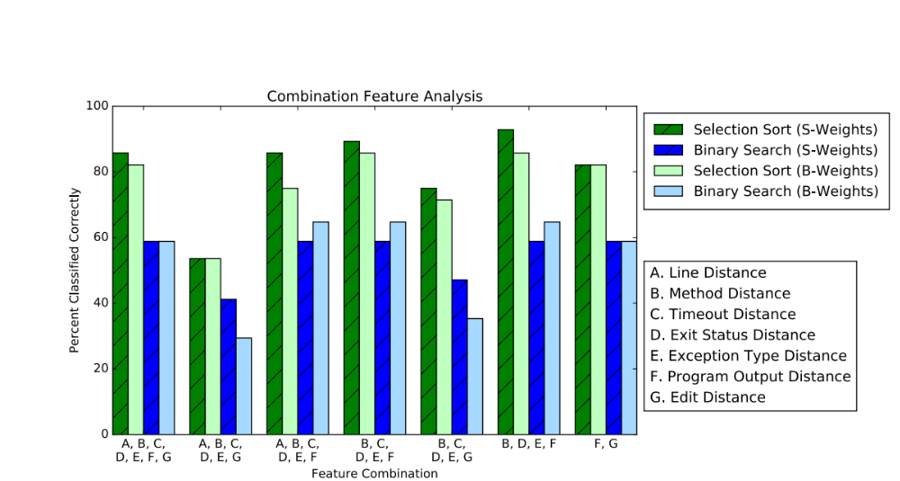
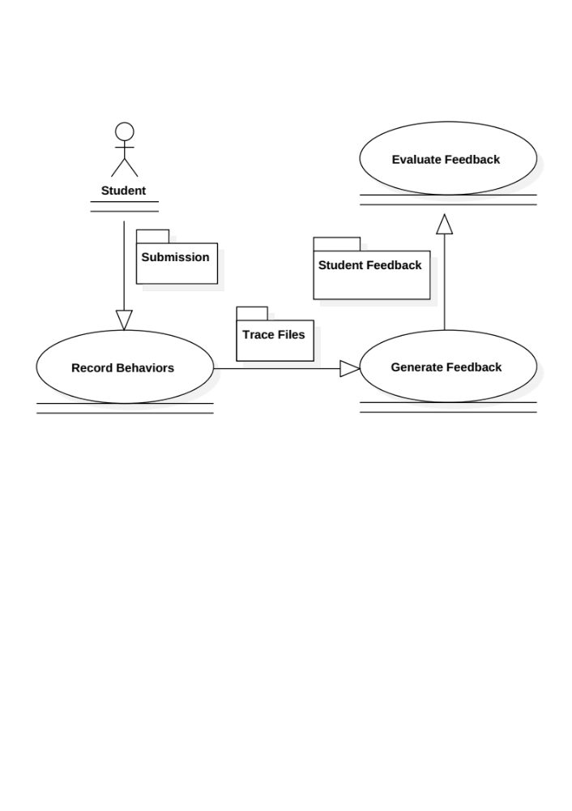
Automated Program Feedback
Andre Leone, Ryan Hartman, Calvin Winget
Faculty Advisors: Dr. Ryan Stansifer & Dr. Philip Chan, Dept. of Computer Sciences, Florida Institute of Technology
Introduction
Grading programs for introductory classes is a time consuming process, and it takes even longer if you want to provide feedback on why their program is incorrect. We created an automated tool that can assign feedback to submitted programs based on the behavior and source code of the program. Professors can receive student submissions and assign feedback to them creating a reference set of programs. This reference set can be used to assign feedback to new student submissions. When new unique bugs appear the professor can add these to the reference set.
Far
1. Record Behaviors
Compile programs Instrument Java Byte Code Run each program against each test case Extract feature data Record trace files
2. Generate Feedback
Compute distance vector for each test case and each reference program Sum the distance vectors for each test case Take the magnitude of each distance vector Assign all submitted programs the feedback from the reference program that it is closest to
Close
3. Evaluate Feedback
Check if the feedback assigned to the submission matches the expected feedback for the submission
Correct Match
Expected Match
Incorrect Match
Features
Edit Distance – Number of operations to change one trace files feedback to match another trace file Line Distance – Difference in lines of source code Method Distance – Count of different calls to list Exit Status Distance – Difference between operating system exit codes Timeout Distance – Difference between timeout statuses Exception Type Distance – Difference between java exception types Program Output Distance – Difference between output of programs
Conclusions
Using feature combinations outperforms any single individual feature Method distance (45%) is able to approximate the performance of edit distance (51%) in a fraction of the time The system correctly matched 93% of student submissions With little computational overhead students can receive personalized feedback compared to current feedback systems (ex. test cases) 5/7 feature combinations outperformed program output distance

